Slide 1
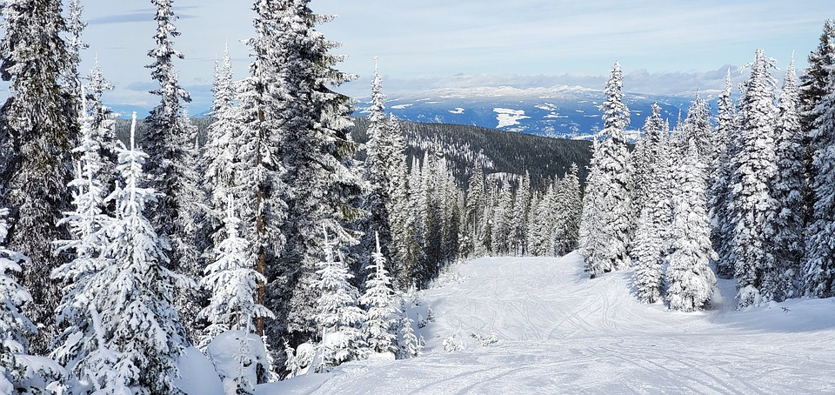
Big Mountain Resort

Slide 2
Problem Statement:
In what ways can Big Mountain Resort better price their tickets by maximizing facility resources?
Current Strategy:
Big Mountain Resort currently only prices on charging a premium based on average prices in its market segment
What does this mean?
Big Mountain Resort only charges based on average prices of other resorts rather than taking in the value of their own resort facilities. This also means they don’t charge a different price for Weekend vs. Weekday prices
So what next?
Initial ideas were to work out a ticket bundle packages
Lower Weekday prices
Group Packages
Season Passes with blackout dates (Disneyland)
Premium tickets with premium access to other facilities that lower tier tickets might not have access to

Slide 3
Problem Solved!
Solution 1
Increase your vertical drop by 150ft!
You can increase ticket price by $8.61 and potential increase of revenue by $15,065,47
Solution 2
Increase snow making by 2 acres
You can increase ticket price by $9.90 and potential increase of revenue by $17,322,717
Solution 3
Closing down 1 run would have no effect to ticket pricing and would help to reduce operating costs.
However!
Closing down more than 1 run could potentially be helpful but would affect ticket pricing. Need operating costs to know more

Slide 4
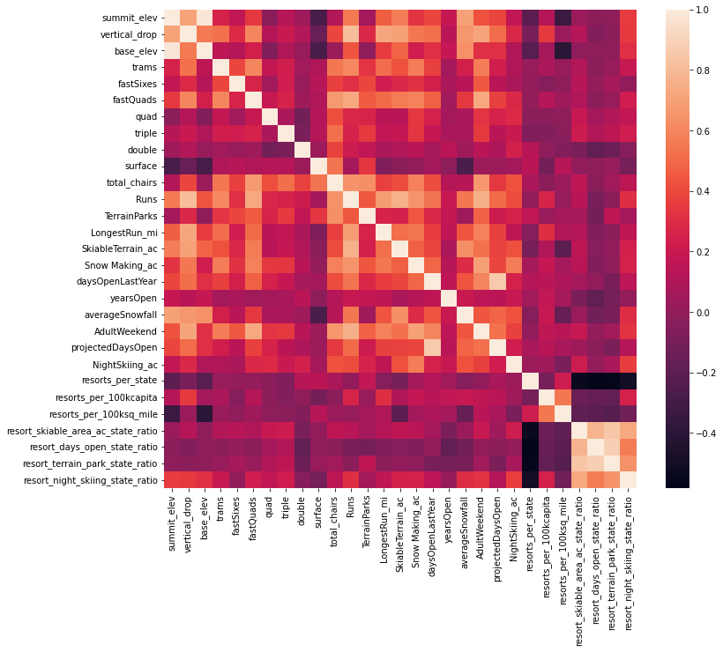
Rudimentary Analysis
Heatmap Correlations (See Figure)
~Vertical drop
~Runs/Snow Making_ac
~Runs/Total_chairs
Using Means and Medians as a baseline training model
~Off by $19 on average!

Slide 5
Random Forest Regression Model vs. Linear Model
Imputing missing values with median/mean
Median proved better due to skew of data
Scaling data
Many features = many different measurements
Zero the data!
Training the model
Training set vs Testing set
Calculate Model Performance
R2 Score, MAE, MSE
SelectKBest and Cross Validation

Slide 6
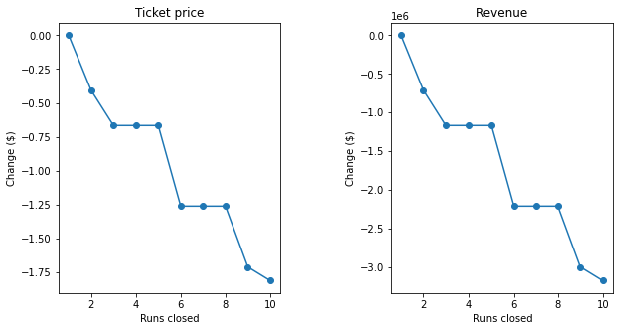
Performing the Model!
A look back at Heatmap Correlation and Best Features
Vertical_drop, Snow Making_ac, Total_chairs, fastQuads, Runs, LongestRun_mi, trams,SkiableTerrain_ac
Only thing now is to use model!
Permanently closing down up to 10 of the least used runs. This doesn't impact any other resort statistics.
Increase the vertical drop by adding a run to a point 150 feet lower down but requiring the installation of an additional chair lift to bring skiers back up, without additional snow making coverage
Same as number 2, but adding 2 acres of snow making cover
Increase the longest run by 0.2 mile to boast 3.5 miles length, requiring an additional snow making coverage of 4 acres

Slide 7
Thank you!
Knowing your best features is important
Have Training and Testing splits
How well Model performs vs. Average or what you currently use is key
Be flexible and have options!

